Slide 1
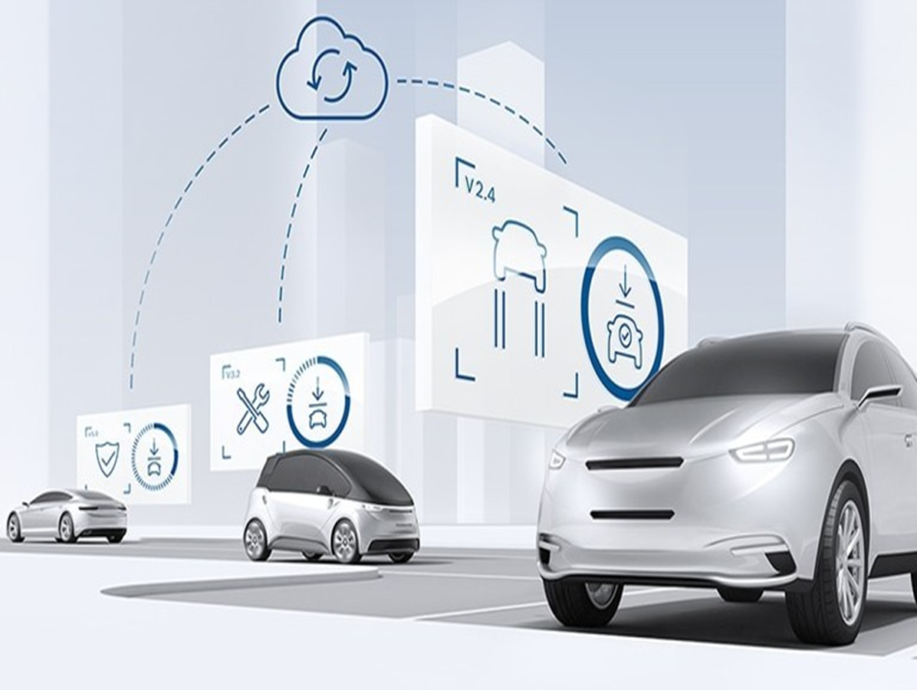
Firmware Over-The -Air (FOTA)

Slide 2
Project analysis slide 11
Team Members
1- NourEldeen Mohamed Abdul Mohsen
2- Ahmed Ibrahim Ali
3- Mohamed Mohy Fayad
4- Yasser Mostafa
5- Emad Mohamed Mahdy
6- Yassmin Muhammad Abdellatif

Slide 3
Project analysis slide 2
Content
Introduction
CAN
PROJECT
FOTA
SERVER CLIENT
BOOTLOADER
Future Plan

Slide 4
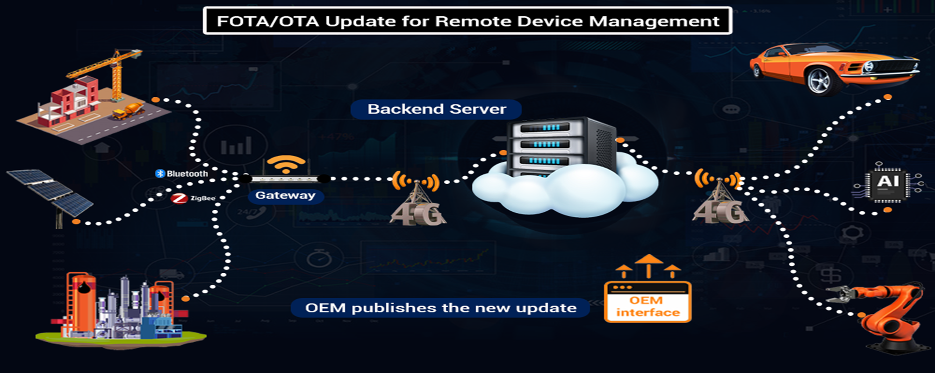
Project analysis slide 5
FOTA/OTA Applications

Slide 5
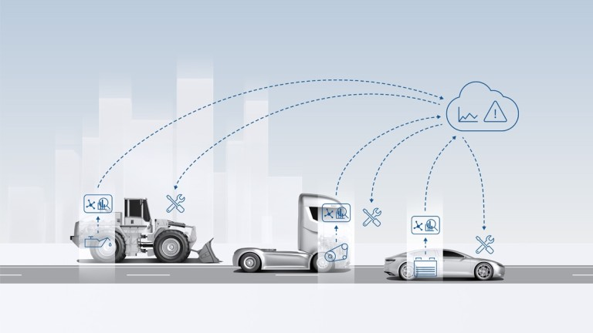

Project analysis slide 3
FOTA in Automotive
FOTA
Firmware Over-The-Air (FOTA) update is a remote software-management technology for embedded systems, which facilitates wireless firmware upgrade on a device.
FOTA upgrade involves firmware bug fixes, improving the automotive ECU’s functionality, and replacing older firmware version with an updates version (for either fixing an issue or to add a new software feature).

Slide 6
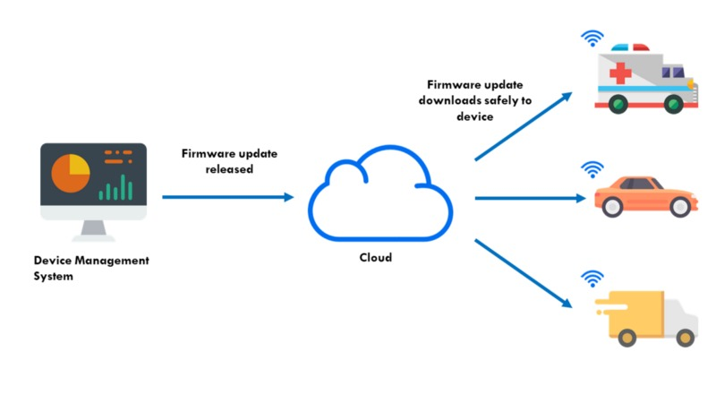
Project analysis slide 3
Why is FOTA?
FOTA

Slide 7

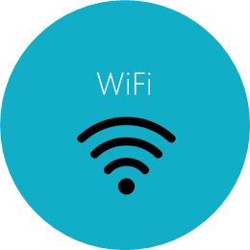




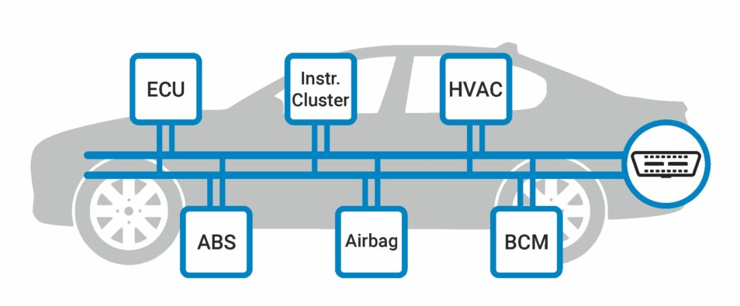

Project analysis slide 4
Project Block Diagram
OEMs
Server
Main ECU
CAN
App ECU

Slide 8
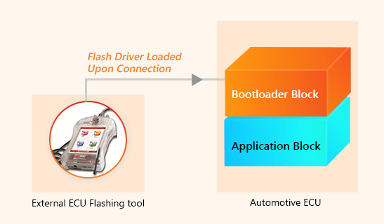
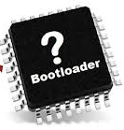
Project analysis slide 3
What is BOOTLOADER?
BOOTLOADER
The Bootloader is stored in a protected ECU memory area and is started as the first software instance in the boot phase after a reset. It then checks whether a flash request or valid application software exists.
If the ECU is to be reprogrammed, the Bootloader starts reprogramming and - after verifying access authorization - loads the flash driver from the bus system to the ECU’s RAM memory if needed.

Slide 9






Project analysis slide 3
Why we used BOOTLOADER?
Flash Bootloader Development Services:
Bootloader sequence development as per the customer/project requirements (Jump to Boot, Erase App, Download App, Validate and Reset sequence).
Memory mapping between the Flash Bootloader software and automotive ECU Application.
CAPL Script or Bus Master Script development to support ECU reprogramming.
Base software development (Flash driver, MCU, Timer and more) in accordance with the bootloader software design.
Flash Bootloader software integration with the customer’s hardware platform.

Slide 10
Project analysis slide 11
Flash Memory Map
BOOTLOADER
0x08000000
0x08002800
BANK 1
0x08014000
BANK 2
0x0801FFFF

Slide 11
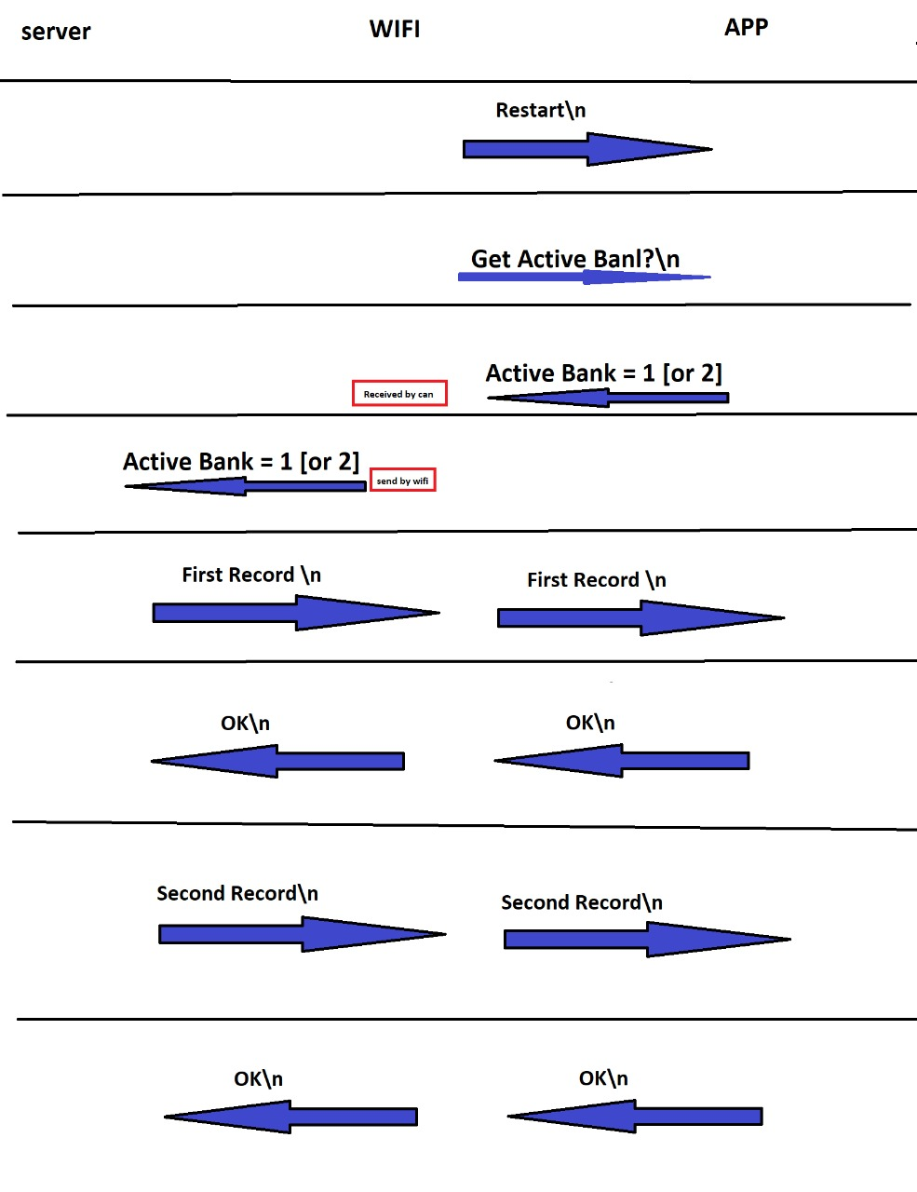
Project analysis slide 3
Data Flow

Slide 12
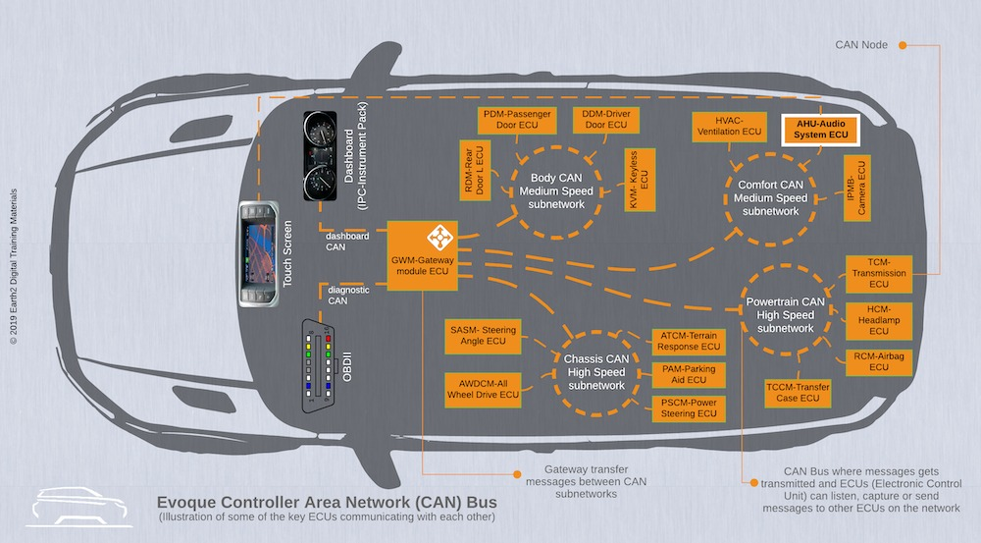
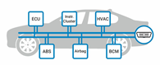
Project analysis slide 3
What is CAN?
CAN
CAN stands for controller area network. They are designed specially to meet the Automobile Industry needs.
Before CAN was introduced, each electronic device is connected to other devices using many wires to enable communication. But when the functions in the automobile system increased, it was difficult to maintain because of the tedious wiring system. With the help of the CAN bus system, which allows ECUs to communicate with each other without much complexity by just connecting each ECU.

Slide 13
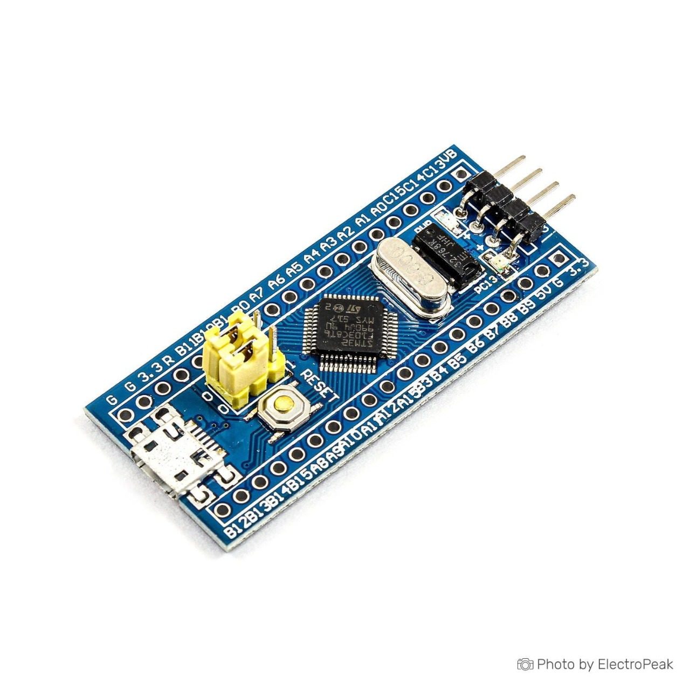
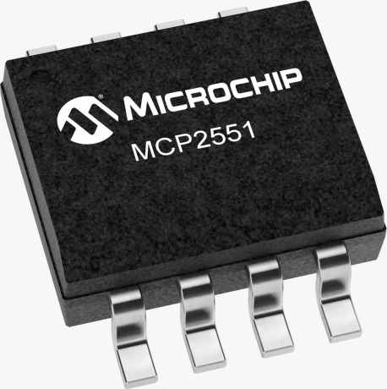
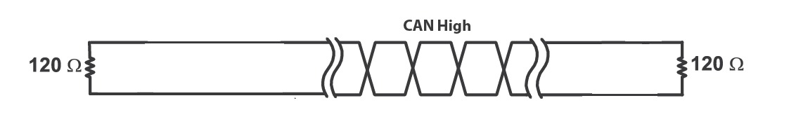
Project analysis slide 3
CAN BUS

Slide 14

Project analysis slide 3
Server-Client
Server-Client System
Firmware is uploaded to a server that constantly listens for connection requests. Main ECU uses Wi-Fi module to send connection request to the server. Once connection is established, main Ecu requests the updated version uploaded to the server and compares it with the current version obtained from app ECU. Upon mismatch, the most updated version is transferred as a hex file to the main ECU line by line.

Slide 15
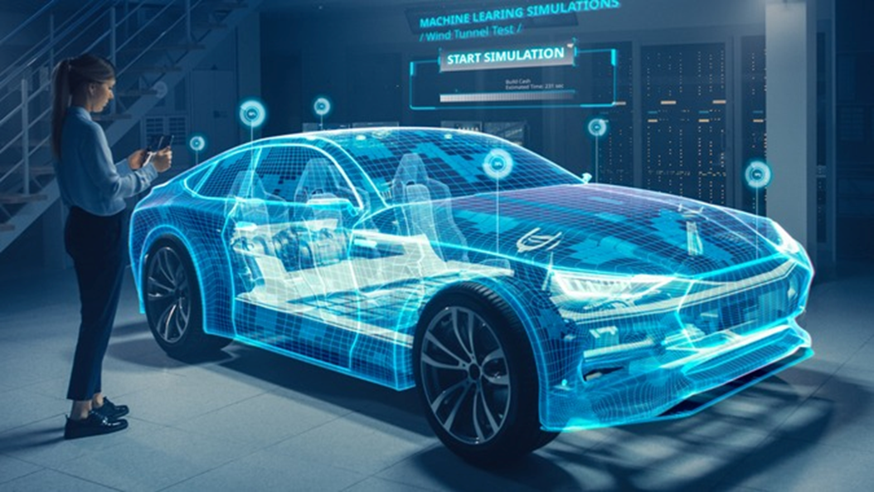
Project analysis slide 5
What is Next?
build CAN driver using AUTOSAR standard
building complete websites for firmware updates
using encryption algorithm between server and main ECU

Slide 16
Thank You

